Slide 1

DIGITAL LOGIC AND COMPUTER ARCHITECTURE (CSA2003)
FIXED POINT ARITHMETIC
Presented by:
23BAI11214 - JUNGARE PARIGH AMBADAS
23BAI10724 - THILAK RAAJ GANESAN
23BAI10917 - VIJAY RAJESH R
Presented to:
Dr. Pratosh Kumar Pal
Assistant Professor, G2
SCAI
VIT Bhopal University
Bhopal-Indore Highway, Kothri Kalan, Sehore
Madhya Pradesh – 466114

Slide 2
Contents
Theory
Pros/Cons
Example Questions
Applications
Objective Type Questions/Answers
Subjective Type Questions
References

Slide 3
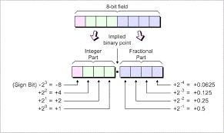
Theory
Fixed Point numbers:
Fixed binary point: The position of the binary point is fixed, determined by the data type or format.
Integer and fractional parts: The number is divided into two parts: an integer part to the left of the binary point and a fractional part to the right.
Fixed Point Addition involves adding numbers with a fixed decimal or binary point. This means the position of the point is consistent throughout the calculation, simplifying the process.

Slide 4
Problems:
Question 1): Add 97.73 and 2.27
Question 2): Why might fixed-point arithmetic be preferred over floating-point arithmetic in embedded systems and digital signal processing applications?

Slide 5
SUBSTRACTION:
Let's use a simple example to fixed-point subtraction. Imagine we're working with numbers that have only one fractional bit.
Question 1): Subtracting 0.75 from 1.5 using a fixed-point format with two fractional bits.
Binary Conversion :
2’s complement :
0.25 = 001
0.25 = 001
0.75 = 011

Slide 6
SUBSTRACTION:
Adding those numbers
0.75 and 2’s complement of 0.25
011 + 111 = 1010 (discarding the carry)
Converting back to decimal
010 = 0.5

Slide 7
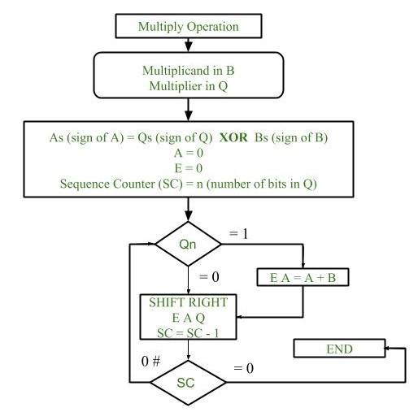
MULTIPLICATION:
Consider the flow chart →
Example:
23 = (10111)
19 = (10011)
23*19 = 437
437 = (110110101)

Slide 8
Pros/Cons
PROS :
Performance: Fixed-point arithmetic can be faster and requires less hardware than floating-point arithmetic, making it useful in performance-critical applications.
Predictability: Fixed-point representation has predictable precision and range, which can be important in real-time systems where consistent timing and behavior are crucial.

Slide 9
CONS :
Limited Range: Fixed-point numbers have a limited range compared to floating-point numbers, which can represent very large or very small numbers.
Scaling Issues: The programmer must manage scaling manually, which can complicate arithmetic operations and increase the risk of overflow or underflow errors.

Slide 10
Applications
Embedded systems: Characterized by resource constraints and real-time requirements, embedded systems heavily leverage fixed-point arithmetic for efficient and deterministic computations. Applications span from IoT devices to critical control systems, optimizing performance and power consumption.
Digital Signal Processing (DSP): DSP systems process analog signals digitally, relying heavily on fixed-point arithmetic for efficient handling of large datasets at high speeds. Applications include audio codecs, digital radio, and video processing, where real-time performance is essential.

Slide 11
Game development and computer graphics: To optimize performance and energy efficiency on resource-limited platforms, game development extensively employs fixed-point arithmetic for physics calculations, graphics transformations, and animation. This ensures smooth gameplay and responsive interactions.
Scientific computing and control systems: While floating-point is dominant, specific applications within scientific computing and control systems benefit from fixed-point arithmetic due to its deterministic behavior and high performance. Examples include robotics and industrial automation where precise control is crucial.

Slide 12
Objective Type Questions/Answers
Question 1): What is the result of adding two fixed-point numbers 3.5 and 2.75 in Q4.4 format?
a) 6.25 b) 5.75 c) 6.00 d) 5.50 Answer: A) 6.25
Question 2): What is the result of subtracting 1.25 from 4.5 in Q4.4 format?
a) 3.00 b) 3.25 c) 3.50 d) 3.75 Answer: c) 3.25

Slide 13
Objective Type Questions/Answers
Question 3): What is the result of multiplying 2.5 by 1.5 in Q4.4 format?
a) 3.25 b) 3.50 c) 3.75 d) 4.00 Answer: b) 3.75
Question 4): What is the result of dividing 7.5 by 2.5 in Q4.4 format?
a) 3.00 b) 2.75 c) 2.50 d) 3.25 Answer: a) 3.00

Slide 14
Objective Type Questions/Answers
Question 5): In fixed-point arithmetic, what determines the position of the decimal point?
a) Compiler settings
b) Hardware architecture
c) Programmer's specification
d) Operating system configuration
Answer: c) Programmer's specification

Slide 15
Subjective Type Questions
Q.1) Explain the process of adding two fixed-point numbers. What considerations must be made regarding the decimal point?
Q.2) Describe the steps involved in subtracting one fixed-point number from another. How do you ensure the accuracy of the result?
Q.3) How do you perform multiplication of two fixed-point numbers? Explain how you handle the scaling factor.
Q.4) Detail the procedure for dividing one fixed-point number by another. What are the potential challenges, and how can they be addressed?
Q.5) Give example of a fixed-point arithmetic operation that involves all four operations (addition, subtraction, multiplication, and division). Explain in detail.

Slide 16
References:
YouTube :
https://youtu.be/NcKuKCFAyIs?si=bnZ_50mDZbmOA6qh
https://youtu.be/nSmIFMIlqLI?si=Bb_mv90VMZm2xogF
Books :
https://archive.org/details/digitaldesignfro0000katz/page/n7/mode/2up
https://archive.org/details/digitalsystemdes0000wilk_j5g5/page/n7/mode/2up
https://archive.org/details/367026792DigitalComputerElectronicsAlbertPaulMalvinoAndJeraldABrownPdf1/page/n1/mode/2up

